Slide 1
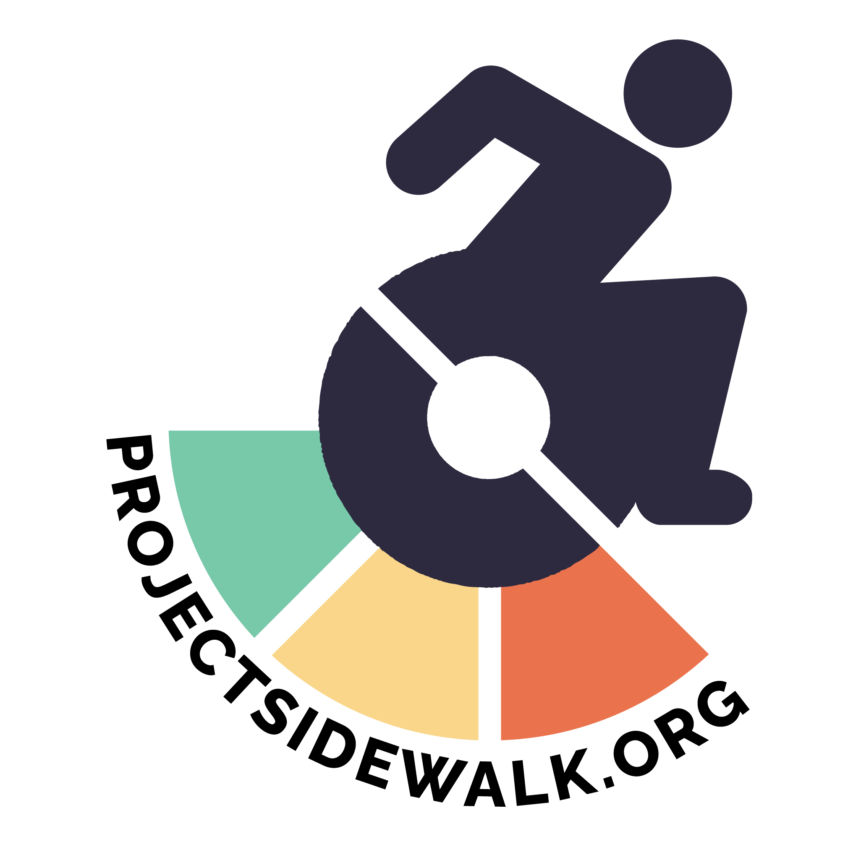
MILESTONE REACHED
Map and assess every sidewalk in the world through AI-powered crowdsourcing

Slide 2
MILESTONE REACHED
Map and assess every sidewalk in the world through AI-powered crowdsourcing

Slide 3
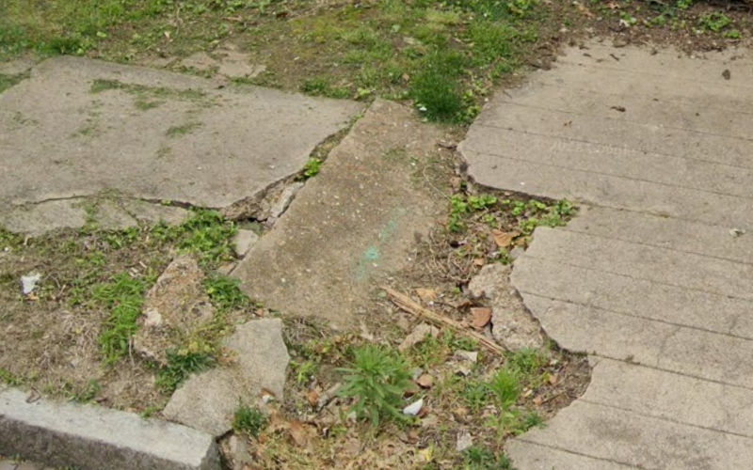
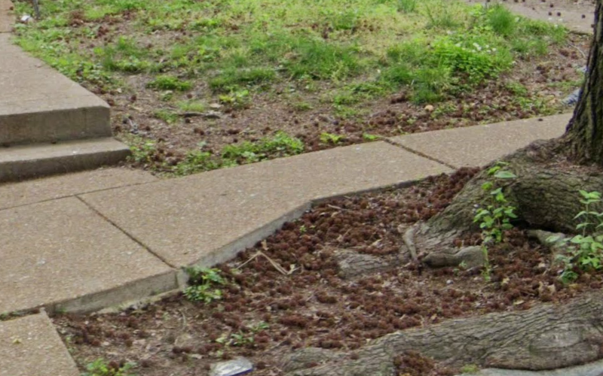
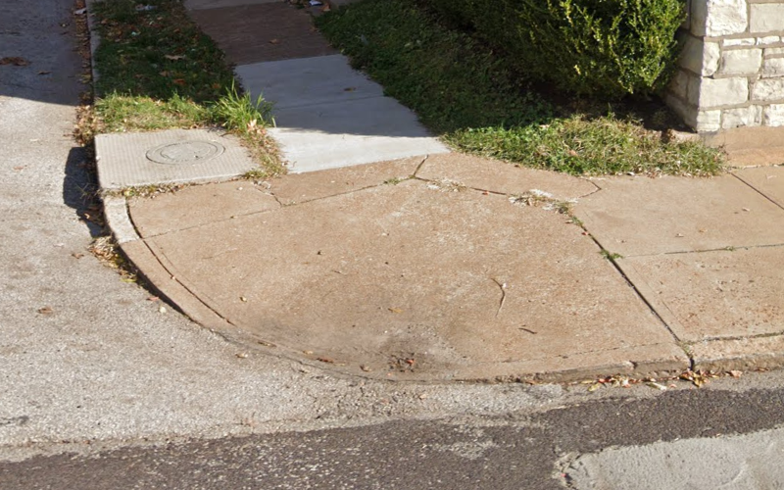
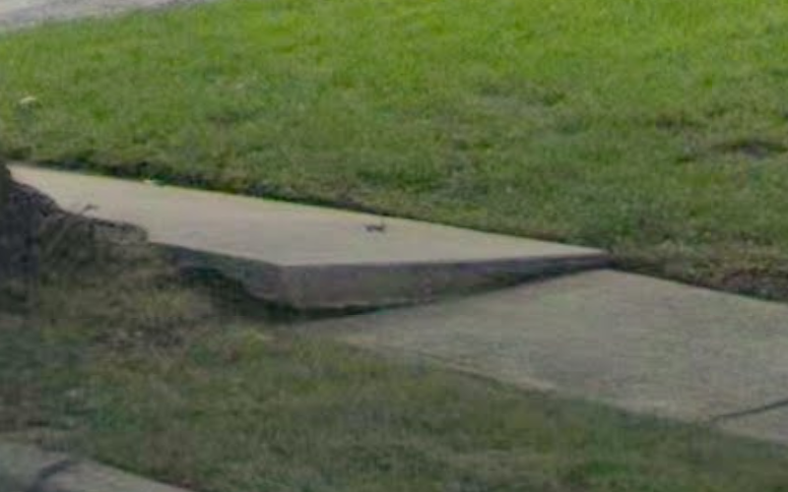
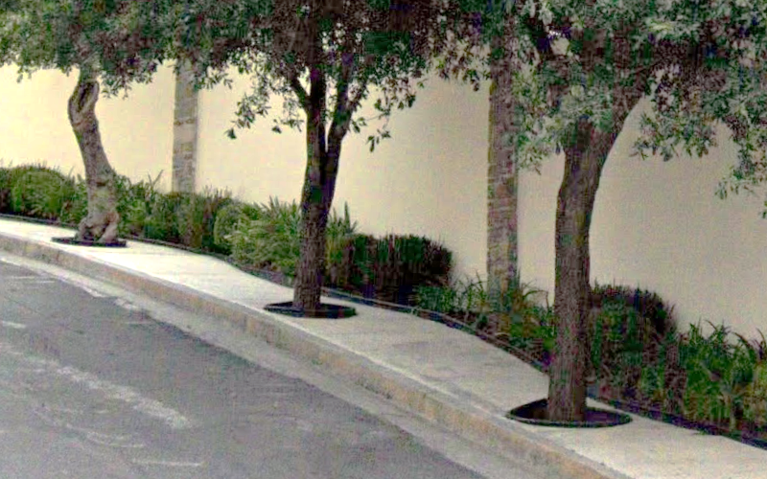
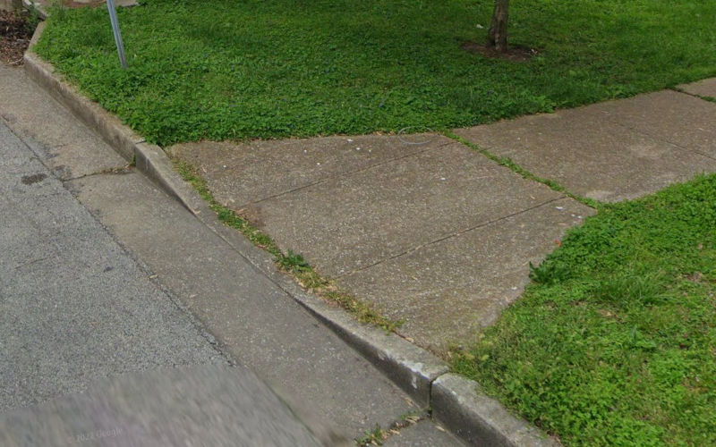
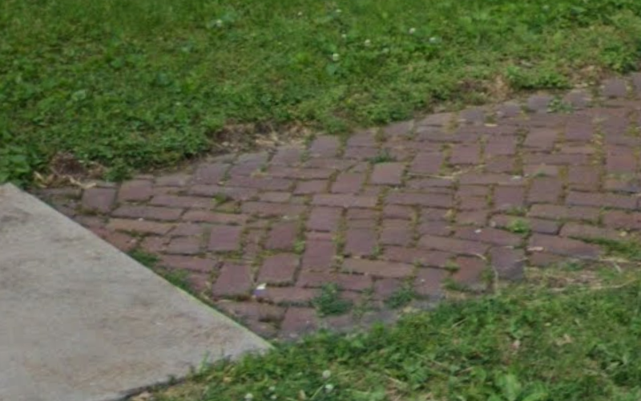
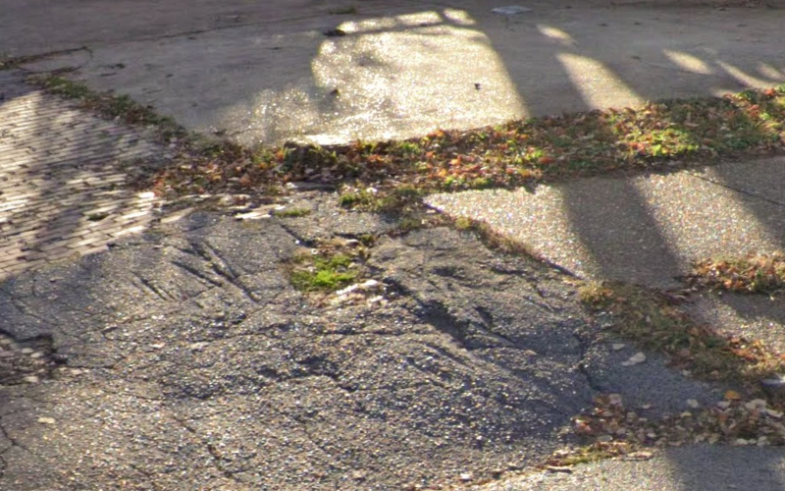
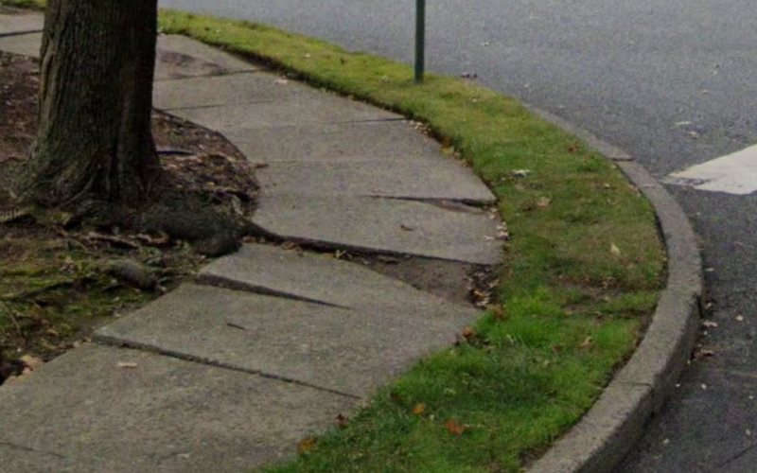
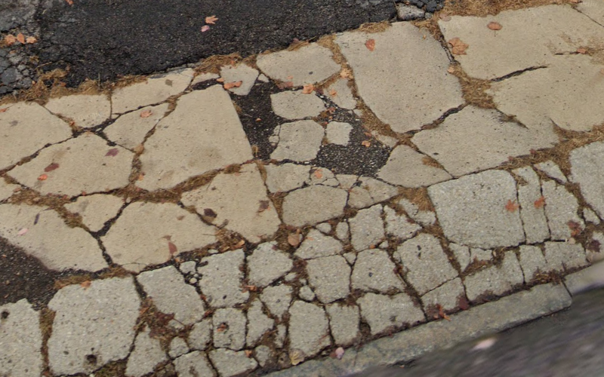
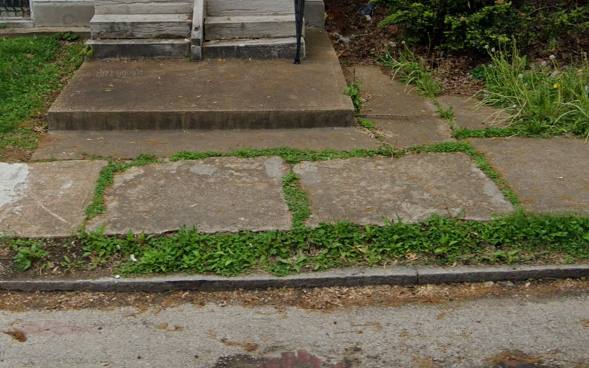
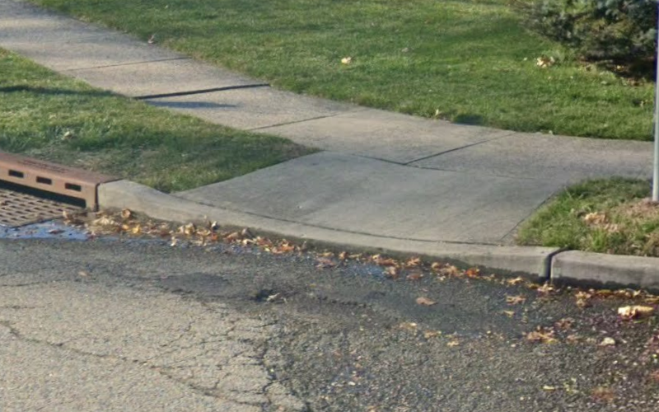
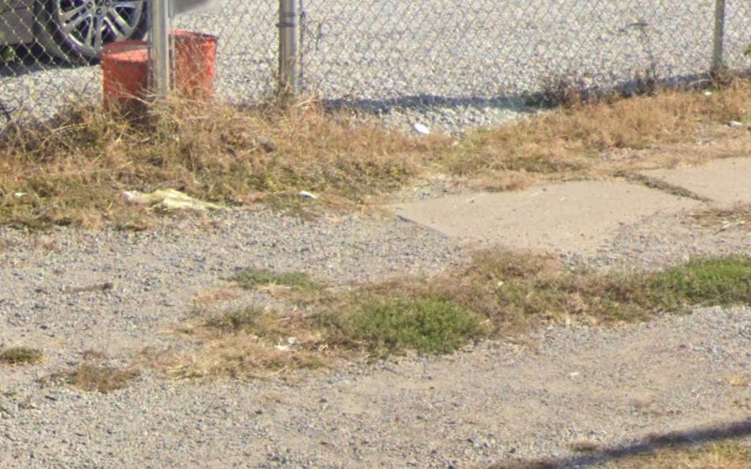
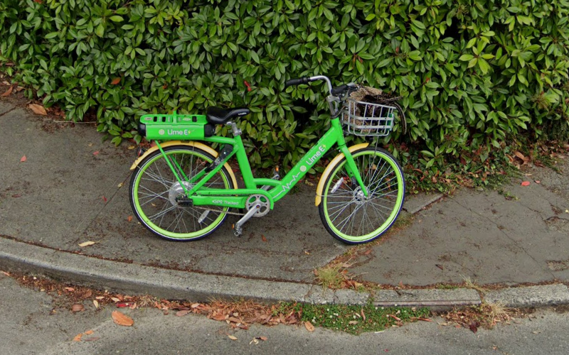
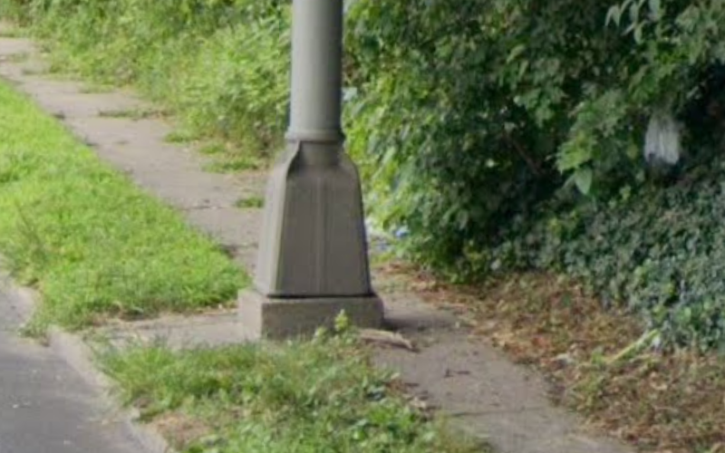
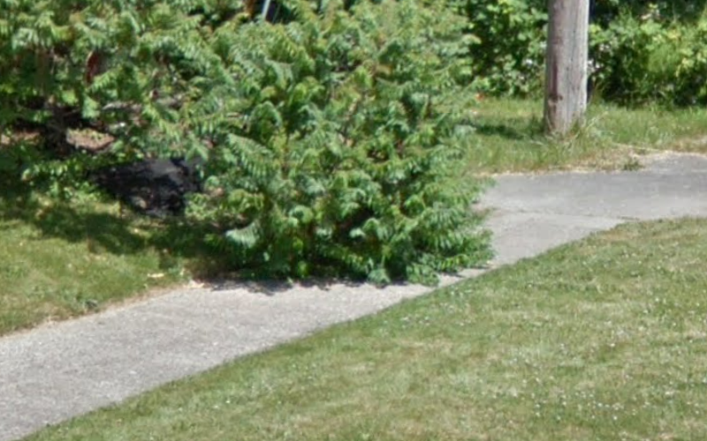
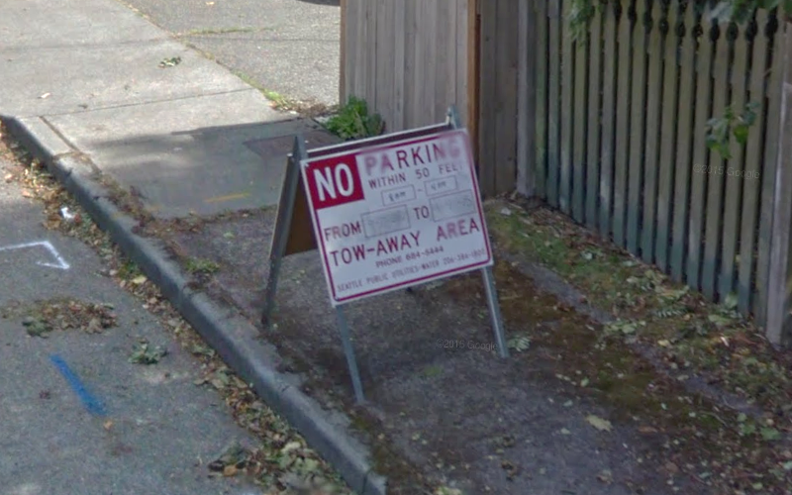
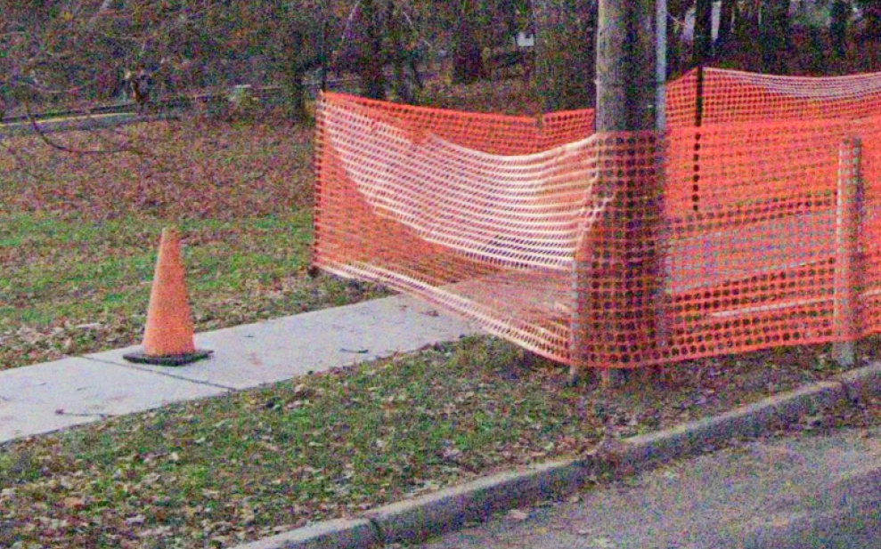
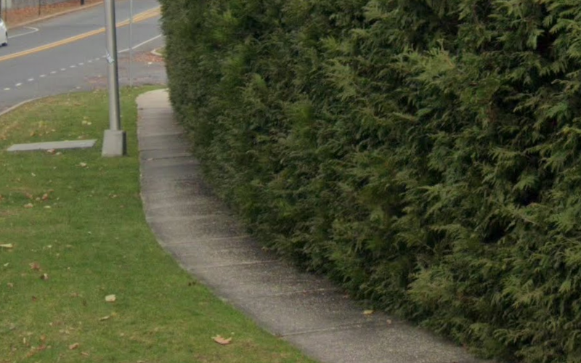
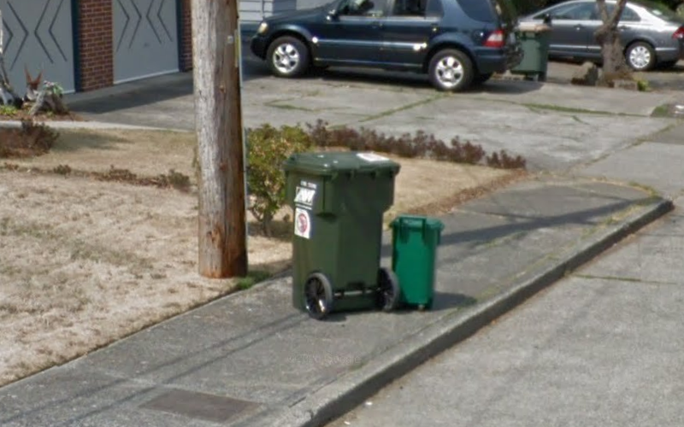
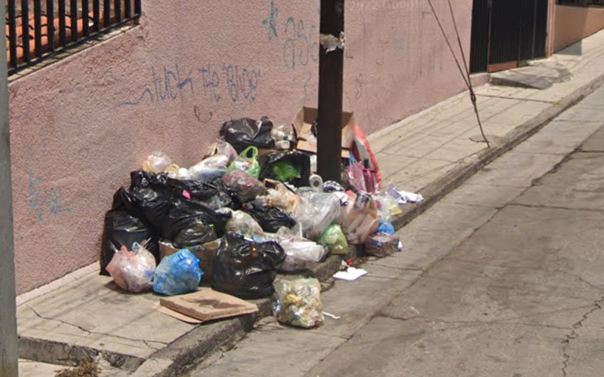
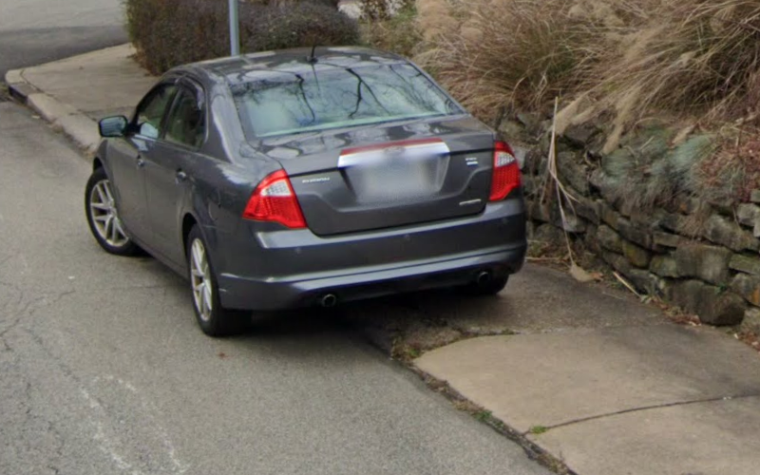
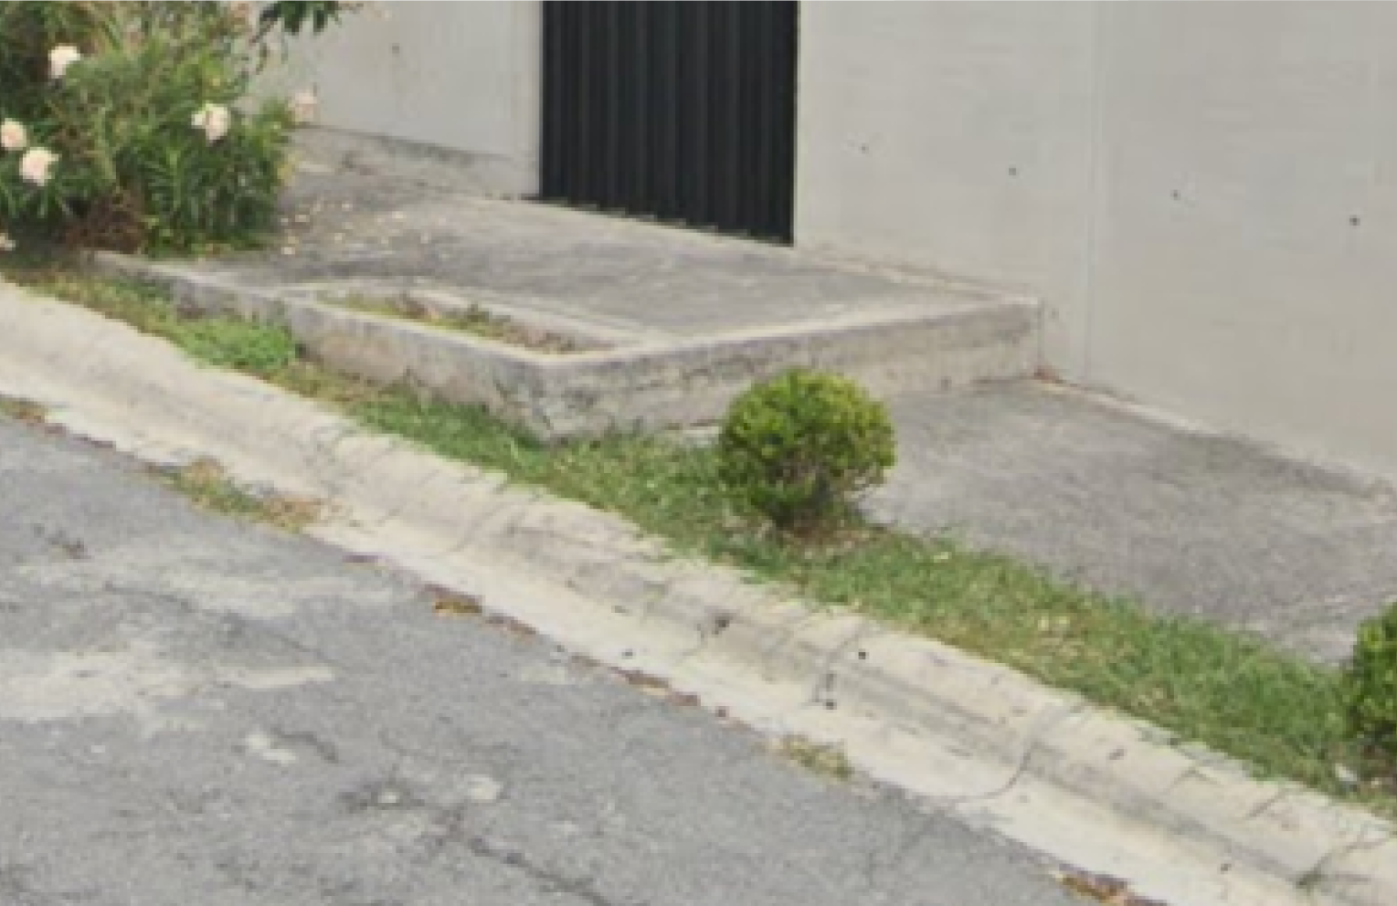
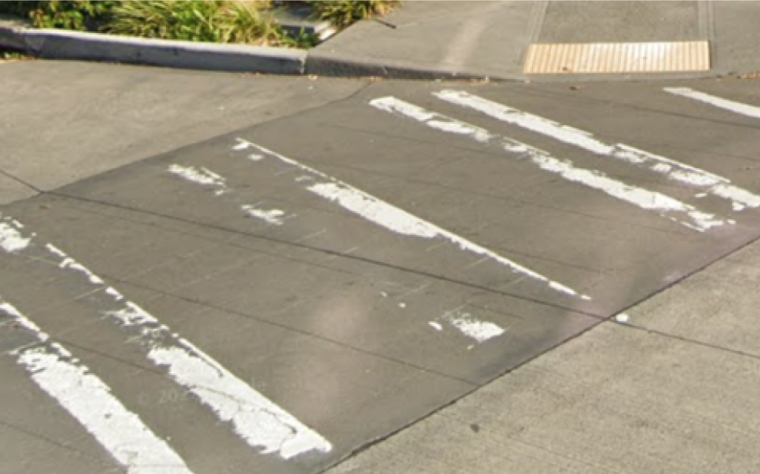
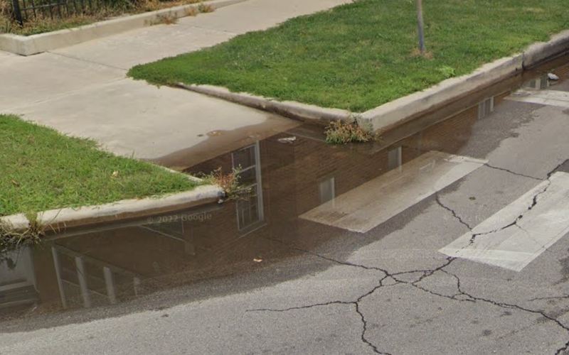
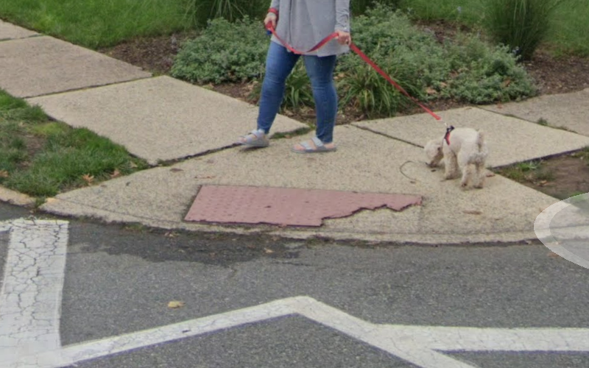
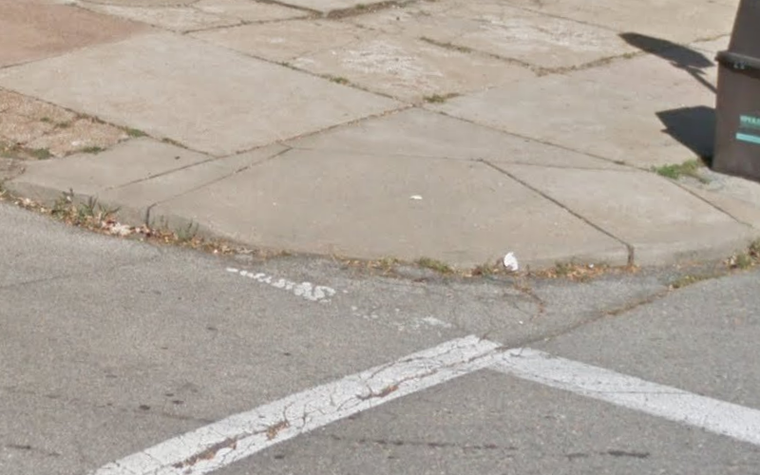
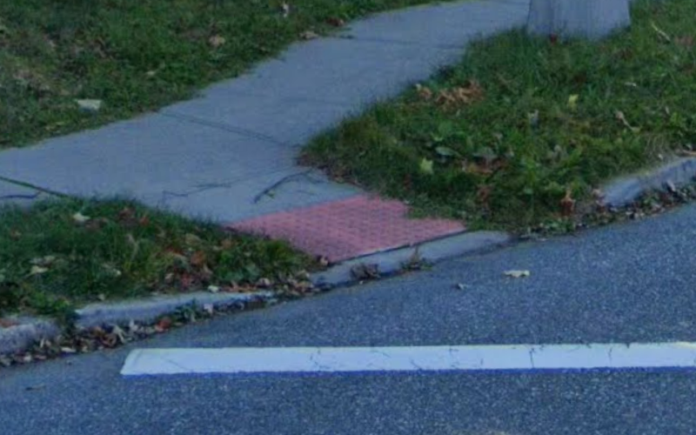
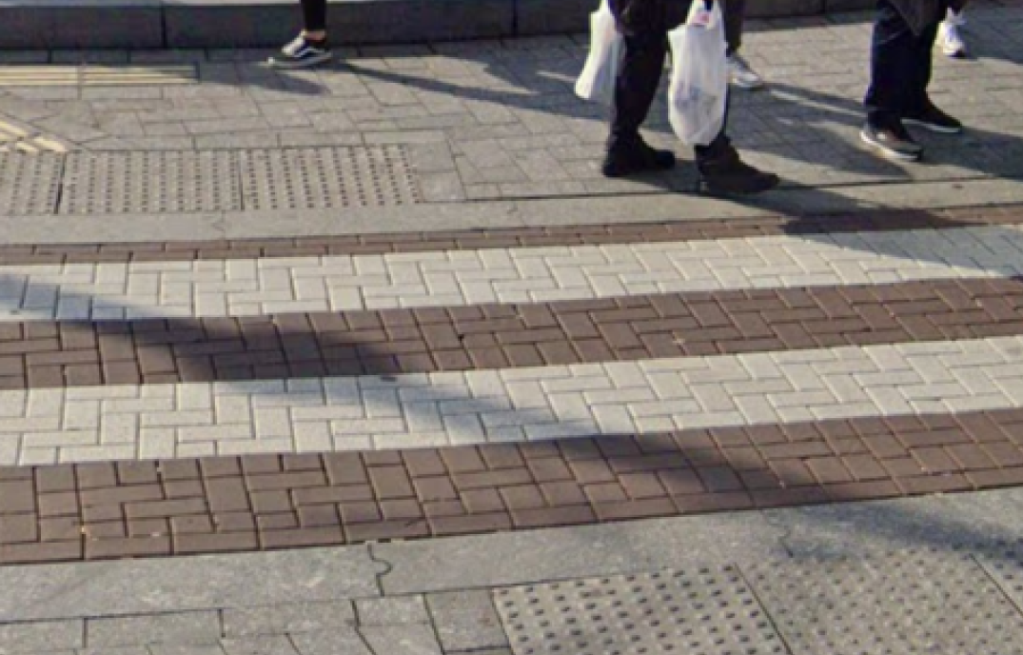
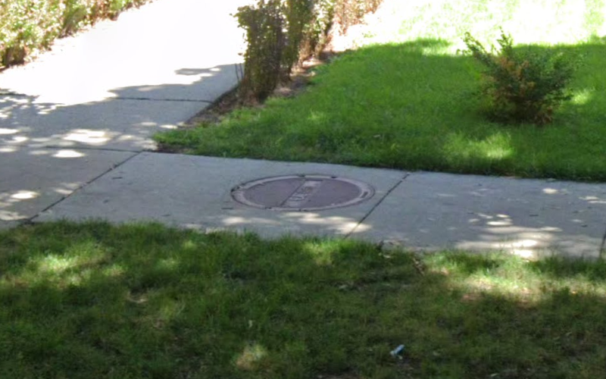
Very broken
Narrow
Not enough landing space
Height difference (uplift)
Tree
Missing tactile warning
MILESTONE REACHED
Brick/cobblestone
Bumpy
Uneven/slanted
Cracks
Grass
Not level with street
Sand/gravel
Parked bike on sidewalk
Pole
Overgrown Vegetation
Sign
Construction
Narrow
Trash/recycling cans
Litter/garbage
Parked car on sidewalk
Stairs
Paint fading
Map and assess every sidewalk in the world through AI-powered crowdsourcing
Pooled water
Surface problem
Points into traffic
Narrow
Brick/cobblestone crosswalk
Utility panel

Slide 4
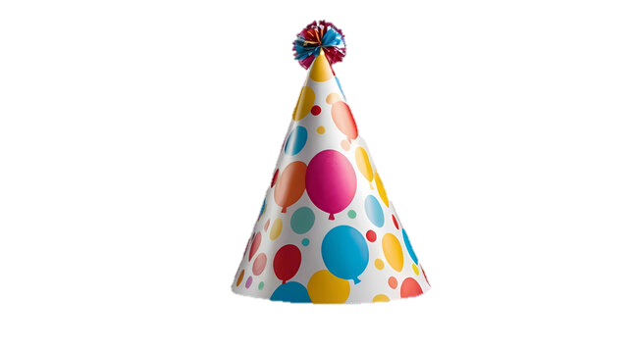
1 Million Labels!
Very broken
Narrow
Not enough landing space
Height difference (uplift)
Tree
Missing tactile warning
Brick/cobblestone
Bumpy
Uneven/slanted
Cracks
Grass
Not level with street
Sand/gravel
Parked bike on sidewalk
Pole
Overgrown Vegetation
Sign
Construction
Narrow
Trash/recycling cans
Litter/garbage
Parked car on sidewalk
Stairs
Paint fading
Pooled water
Surface problem
Points into traffic
Narrow
Brick/cobblestone crosswalk
Utility panel

Slide 5


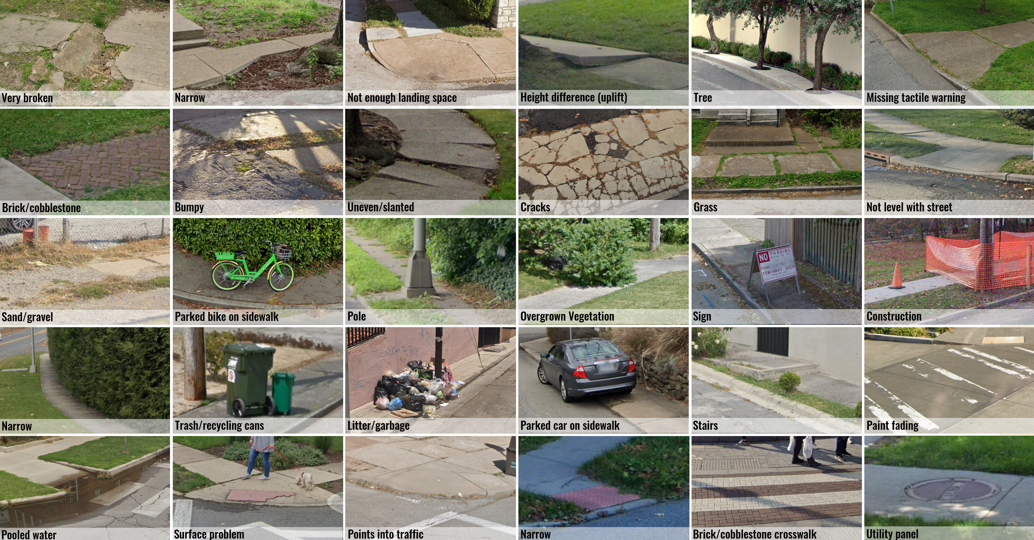
1 Million Labels!
Very broken
Narrow
Not enough landing space
Height difference (uplift)
Tree
Missing tactile warning
Brick/cobblestone
Bumpy
Uneven/slanted
Cracks
Grass
Not level with street
Sand/gravel
Parked bike on sidewalk
Pole
Overgrown Vegetation
Sign
Construction
Narrow
Trash/recycling cans
Litter/garbage
Parked car on sidewalk
Stairs
Paint fading
Pooled water
Surface problem
Points into traffic
Narrow
Brick/cobblestone crosswalk
Utility panel

Slide 6


1 Million Labels!
https://huggingface.co/projectsidewalk
Very broken
Narrow
Not enough landing space
Height difference (uplift)
Tree
Missing tactile warning
Brick/cobblestone
Bumpy
Uneven/slanted
Cracks
Grass
Not level with street
Sand/gravel
Parked bike on sidewalk
Pole
Overgrown Vegetation
Sign
Construction
Narrow
Trash/recycling cans
Litter/garbage
Parked car on sidewalk
Stairs
Paint fading
Pooled water
Surface problem
Points into traffic
Narrow
Brick/cobblestone crosswalk
Utility panel

